Slide 1
More HTML Elements
Introduction to Web development

Slide 2
Agenda
HTML Attributes
HTML Links

Slide 3
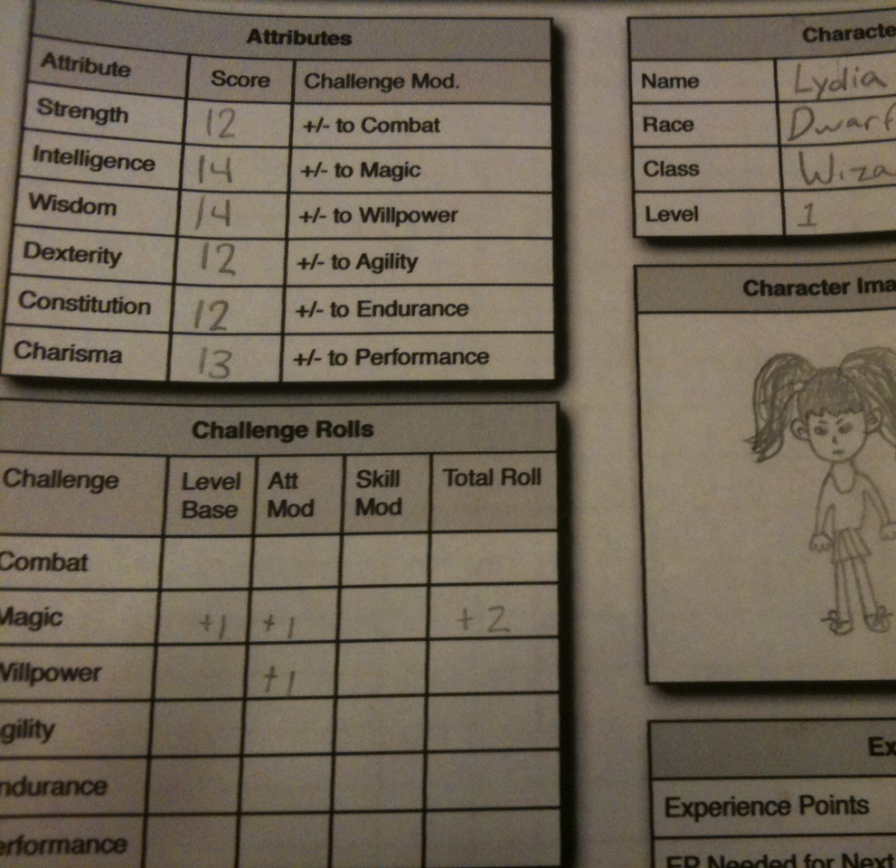
HTML Attributes

Slide 4
Attribute example: The image element
<img src="http://google.com/dog.jpg">
Q: What does the src do?
A: The src attribute tells the website which image to show on the page
Notes:
Ask the students what href does – it tells the link where to go when clicked!

Slide 5
What are attributes?
Attributes add extra information to HTML elements
They change what an element does
Attributes go inside of the opening tag of an HTML element
<img src="picture.jpg">
Attribute name, equals sign, quotation marks, attribute value
Notes:
Point out each part of the attribute syntax

Slide 6
Mini-quiz
<img src="dog.png">
What is the attribute name?
src
What is the attribute value?
dog.png
Notes:
Ask the students these questions

Slide 7
Attributes Examples
https://replit.com/@HylandOutreach/AttributeExamples
Notes:
Visit the Repl to show attributes in action. Uncomment the commented lines of code to display them. You should be able to use Ctrl+/ to comment and uncomment code in Repl

Slide 8

HTML Links
Notes:
Ask the students if they recognize this character. It’s Link from Zelda!

Slide 9
What is a link on a website?
In a website, a hyperlink (or link) is an item like a word or button that points to another location
What is a URL?
A URL is an address that is used to locate resources on the web

Slide 10
How to make a link in html – a element
<a href="http://google.com">Click Me</a>
Where will this link go?
http://google.com
What will the link say?
Click Me
What is the attribute?
href
What is the tag name?
a
Notes:
Show the example of a link – the a or anchor element
Have the students guess the answers to these questions – and then reveal the answers

Slide 11
Link Examples
https://replit.com/@HylandOutreach/LinkExamples
Notes:
Show some examples of links. There are also a couple of broken ones – have the students try to figure out what is wrong with those.

Slide 12
BONUS: Embedding youtube videos
Copy an iframe element from YouTube, and paste it into your HTML!
SHARE – Embed - COPY
Notes:
As a bonus, show students how it is possible to embed most youtube videos on their websites.

Slide 13
Embedded Youtube Video Example
https://replit.com/@HylandOutreach/YouTubeEmbed
Notes:
Show an example of a website that contains an embedded YouTube video.

Slide 14
Questions?

